Slide 1


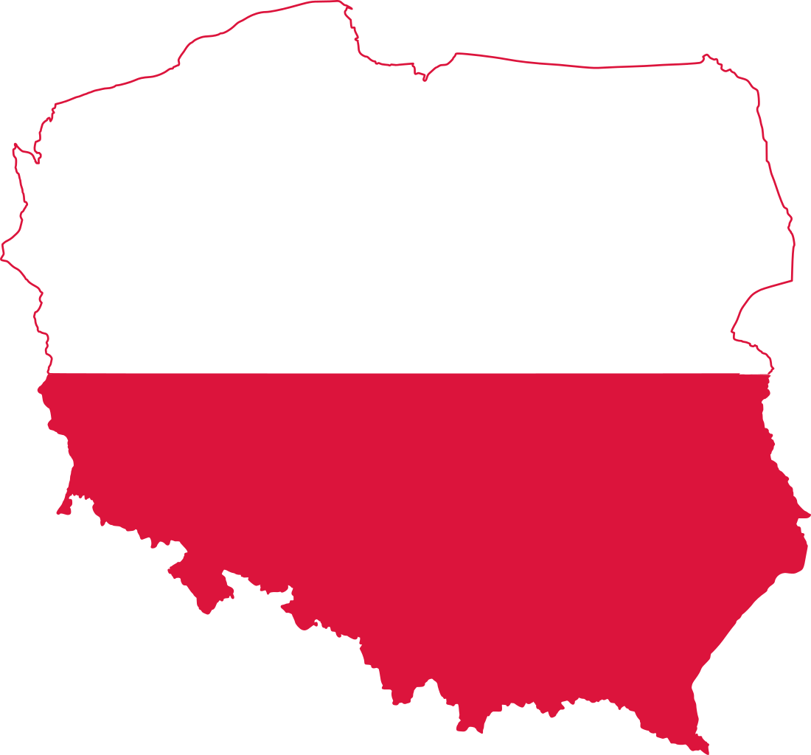
Monitoring Committee Sections Update

Slide 2
Context
In Autumn 2020, we launched a monitoring procedure for Montenegro for non-payment of membership fees over successive years, and no sign of life.
In November 2021, we launched a monitoring committee for Poland for political instability, code of Conduct breaches, lack of a bank account and legally binding statutes.
Current members of the monitoring committee are Christelle Savall (EB), Anna van de Moosdijk (FC), and Caroline Kokholm-Jørgensen (national delegate of JEF Denmark).
The Monitoring Committee recommends to continue the monitoring procedure for Montenegro until the new volunteers take over the registration and the monitoring procedure for Poland until the section is up and running.

Slide 3
Montenegro
Montenegro has not been paying membership fees since 2016, there has been no sign of life.
A formal expulsion letter was sent in 2021.
Robin, former EB contact person for Montenegro, has identified a new group of people
They got in touch with the old board and found a way to have the old JEF Montenegro handed over
They updated their statutes and are right now translating them into English
The only thing missing is the constitutive assembly where they will officially elect a new board
Procedure continues until the new volunteers officially take over the registration.

Slide 4
Poland
Still not a consistent level of activity, but a growing number of members and a new GA took place on October 27th.
There is still not a solid democratic structure even if there have been improvements.
The EB has been contacted by several interested people in helping support activited of JEF in Poland. They have been put in tontact with JEF poland by Aléxandros, contact person in the EB.
Procedure to continue to monitor the process and to support a smooth relaunch of the section.

